Slide 1
TestNG Annotations
Below is the list of annotations:-
@Test – This marks a class or a method as a part of the test.
@BeforeSuite – The @BeforeSuite method in TestNG runs before the execution of all other test methods. It will run only once before all tests in the suite have to run.
@AfterSuite – The @AfterSuite method in TestNG runs after the execution of all other test methods. It will run only once after all tests in the suite have run.
@BeforeTest – The @BeforeTest method in TestNG runs before the execution of first @Test method. It runs only once per class.
@AfterTest – The @AfterTest method in TestNG executes after the execution of all the test methods that are inside that folder.

Slide 2
@BeforeClass – The @BeforeClass method in TestNG will run before the first method invokes of the current class.
@AfterClass – The @AfterClass method in TestNG will execute after all the test methods of the current class execute.
@BeforeMethod – The @BeforeMethod method in TestNG will execute before each test method.
@AfterMethod – The @AfterMethod method in TestNG will run after each test method is executed.
@BeforeGroups – The @BeforeGroups method in TestNG run before the test cases of that group execute. It executes just once.
@AfterGroups – The @AfterGroups method in TestNG run after the test cases of that group execute. It executes only once.
@Parameters –This annotation is used to pass parameters to test methods.

Slide 3
@DataProvider – If we use @DataProvider annotation for any method that means you are using that method as a data supplier. The configuration of @DataProvider annotated method must be like it always return Object[][] which we can use in @Test annotated method. The @Test method that wants to receive data from this DataProvider needs to use a dataProvider name equals to the name of this annotation.
@Factory – Marks a method as a factory that returns objects that will be used by TestNG as Test classes. The method must return Object[ ].
@Listeners– This annotation is used with test class. It helps in writing logs and results.

Slide 4
Execution process is as follows:
First of all, beforeSuite() method is executed only once.
Lastly, the afterSuite() method executes only once.
@BeforeMethod and @AfterMethod are executed twice, one for Test Case 1 and again for Test Case 2.
Methods beforeTest(), beforeClass(), afterClass(), and afterTest() methods are executed only once.
To execute this program, we need to Right click and select Run as -> TestNG or Run testng.xml.

Slide 5
Assertions in TestNG
What is Assertion?
Assertions in TestNG are a way to verify that the expected result and the actual result matches or not in the test case
Below are few commonly used assertions in TestNG.
1. Assert.assertEquals(String actual, String expected) – It takes two string arguments and checks whether both strings are equal or not. If they are not, it will fail the test and an AssertionError is thrown.
2. Assert.assertEquals(String actual, String expected, String message) – It takes two string arguments and checks whether both strings are equal or not. If they are not, it will fail the test and an AssertionError is thrown with message provided as argument.
3. Assert.assertEquals(boolean actual, boolean expected) – It takes two Boolean arguments and checks whether both are equal or not. If they are not, it will fail the test and an AssertionError is thrown.
4. Assert.assertEquals(java.util.Collection actual, java.util.Collection expected, java.lang.String message) – It takes two collection objects and verifies both collections contain the same elements and with the same order. If they are not, it will fail the test and an AssertionError is thrown.

Slide 6
5. Assert.assertTrue(condition) – It takes one boolean argument and checks that a condition is true or not. If not, it will fail the test and an AssertionError is thrown.
6. Assert.assertTrue(condition, message) – It takes one boolean argument and checks that a condition is true or not. If not, it will fail the test and an AssertionError is thrown with message provided as argument.
7. Assert.assertFalse(condition) – It takes one boolean argument and checks that a condition is false or not. If not, it will fail the test and an AssertionError is thrown.
8. Assert.assertFalse(condition, message) – It takes one boolean argument and checks that a condition is false or not. If not, it will fail the test and an AssertionError is thrown with message provided as argument.
9. Assert.assertSame(String actual, String expected) – It asserts that two objects refer to the same object. If they do not, an AssertionError is thrown.
10. Assert.assertNotSame(String actual, String expected) – It asserts that two objects do not refer to the same object. If they do, an AssertionError is thrown.

Slide 7
Hard Assert and Soft Assert in TestNG
What is Hard Assert?
Hard Assertion throws AssertionError immediately when an Assert Condition fails and moves to the next @Test method
Suppose, there are 2 assertions in a Test and the first assertion fails, then HardAssertion does not execute the second Assertion Condition and declares the test as failed
As you can see in the below example, there are 2 assert conditions under Test – Assertion Failure(). As the first Assert Condition fails, it moved directly to the second test without executing another Assert Condition.

Slide 9
What is Soft Assert?
Soft Assert does not throw an exception when an Assert Condition fails, and continues with the next step after the Assert Condition.
Soft assert does not include by default in TestNG. For this, you need to include the below package :
1.org.testng.asserts.SoftAssert;
The first step is to create an instance of SoftAssert class.
2.SoftAssert softAssertion = new SoftAssert();
After this, we can use this softAssert variable instead of hard assert.
3.softAssertion.assertEquals(expectedTitle, actualTitle, "Incorrect page title");

Slide 11
AssertAll
If there is any exception, and you want to throw it, then you need to use assertAll() method as a last statement in the @Test and test suite again to continue with the next @Test as it is.

Slide 12
Run TestNG tests from Command Line
Pre-Requisite
Selenium
TestNG
Maven
Java 11
Maven Compiler Plugin
Maven Surefire Plugin
Imagine we need to run the TestNG Tests in CI/CD pipelines like Jenkins or GitLab, then we can’t right-click and select TestNG Suite or tesng.xml to run the tests. In such situations, the tests can be executed through the command line.
We need to add plugins to pom.xml to compile the test code and then run the tests. To know more about Maven Surefire Plugin for TestNG

Slide 13
It is needed to add testng.xml to suiteXmlFile to start the execution of the tests.
<suiteXmlFiles>
<suiteXmlFile>testng.xml</suiteXmlFile>
</suiteXmlFiles>

Slide 14
Also download hamcrest All-- jar

Slide 15
The below commands are used to execute the ‘testng.xml’ file from the command line. First, we need to go the place where the pom.xml of the project is placed. Then use the mvn compile test to compile the code and execute the TestNG tests.
C:\Users\bhara\eclipse-workspace\TestNGDemo>mvn compile test

Slide 17
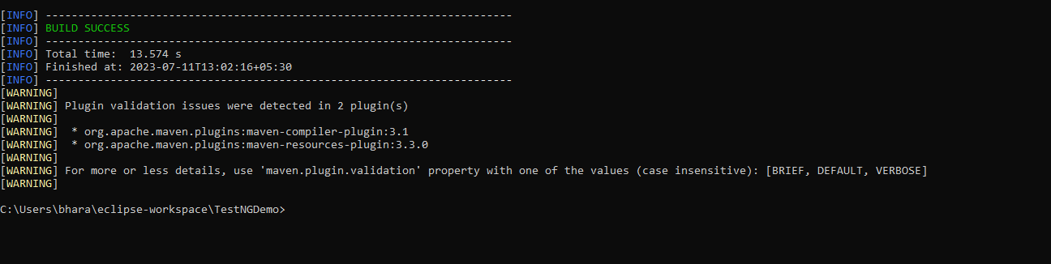

Slide 18
Execute Testng.xml using batch file
A batch file (.bat) is used in DOS and Windows, which is an unformatted text file that consists of a series of commands to be executed by the command line interpreter.
Pre-Requisite:
Selenium
TestNG
Maven
Java 11
Maven Complier Plugin
Maven Surefire Plugin
Notepad
Let us first create some tests in a class.

Slide 20
How to create a batch file?
Step 1: Open notepad
Step 2: Paste the below lines of code – You may need to add your project location. In the example, project location is set as C:\Users\bhara\eclipse-workspace\TestNGDemo
Step 3: Save the file as ‘TestNGProject.bat’ in location that you want to save.
Now, to run the tests, double click on the TestNGProject.bat file and all the commands mentioned in the file will be executed one by one.

Slide 21
How to pass Parameters in TestNG
It is defined as an ability to pass different test data to a test case as arguments, which is called parametrization
There are mainly two ways through which we can provide parameter values to TestNG tests.
Through testng.xml XML configuration file
Through DataProviders
we will discuss using testng.xml for parametrization. If we need to pass some simple values such as String or Integer types to the test methods at runtime, there is something called @Parameter where parameter values through TestNG XML configuration files pass to test.
@Parameters("value")

Slide 22
Let us explain how we can use parameters. To start with, add the below dependencies to the POM.xml in the case of the Maven project.
<dependencies>
<dependency>
<groupId>org.seleniumhq.selenium</groupId>
<artifactId>selenium-java</artifactId>
<version>3.141.59</version>
</dependency>
<dependency>
<groupId>io.github.bonigarcia</groupId>
<artifactId>webdrivermanager</artifactId>
<version>5.1.0</version>
</dependency>
<dependency>
<groupId>org.testng</groupId>
<artifactId>testng</artifactId>
<version>7.5</version>
<scope>test</scope>
</dependency>
</dependencies>

Slide 23
Implementation Steps
Step 1 – Create a JAVA test class, say, TestNGParameterizationDemo.java
Step 2 – Add test method parameterizedTest() to the test class. This method takes a string as an input parameter
Add the annotation @Parameters(“browser”) to this method. The parameter passes a value from testng.xml
Step 3 – Create a TestNG.xml and pass the value of the parameter in this configuration file.
Below is an example that shows the use of Parameters.

Slide 25
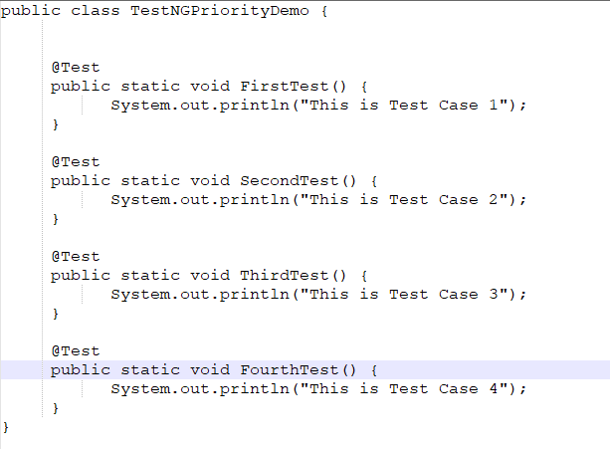
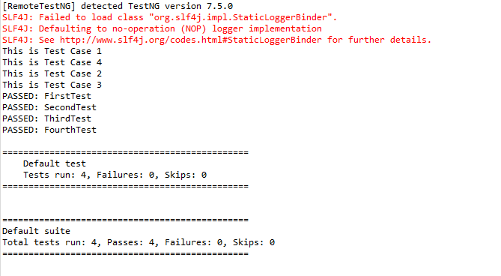
How to prioritize Selenium Test Cases using TestNG Feature
If no priority assigned to a Test Case, then the annotated test methods are executed as per the alphabetical order of the tests

Slide 26
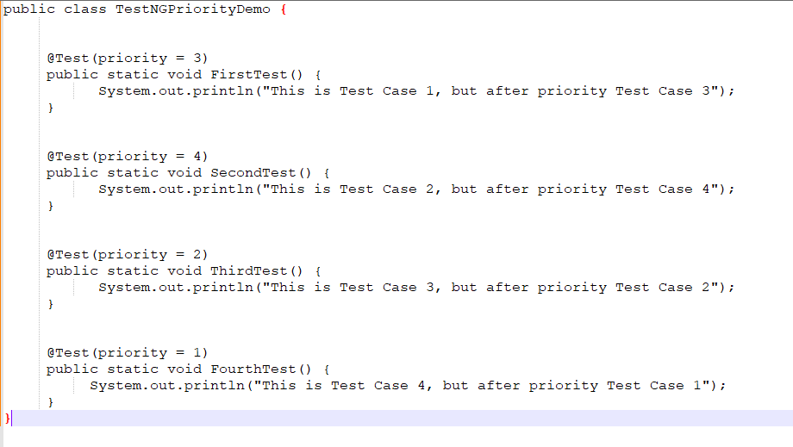
In the above example, FirstTest and FourthTest have the highest preference as per the alphabetical order. F comes before S and T. FirstTest is executed before Fourth because preference of I is higher than O.
The methods can be prioritized by assigning a number to the annotated test cases. Smaller the number, higher the priority. Priority can be assigned as parameters while defining the test cases. In the below example, we have assigned priority to test cases and now they are executed as per the priority. The Test Case with priority = 1 has the highest precedence. It override the rule of executing test cases by alphabetical order.

Slide 27
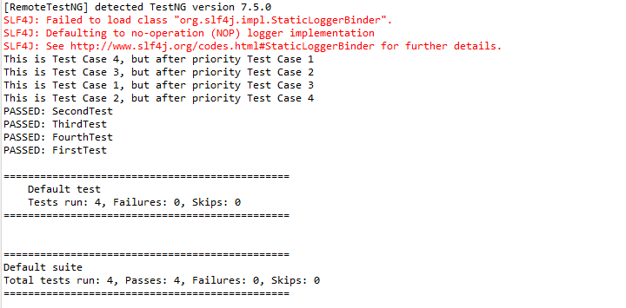
The output of the above program is

Slide 28
How to disable Selenium Test Cases using TestNG Feature – @Ignore
Imagine there are 100 test cases in a Regression Test Suite. We need to execute 99 test cases in a release and do want not to execute any particular test case. But we do not want to delete that test case from the Test Suite also. In this case, TestNG has a feature that allows skipping a particular test case by setting the parameters to.
@Enabled Annotation
@Test(enabled = false)
To use two or more parameters in a single annotation, separate them with a comma:
@Test(priority = 3, enabled = false)

Slide 29
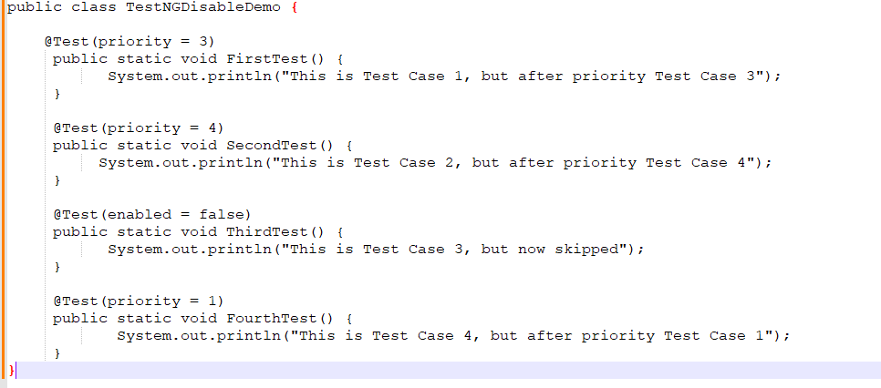
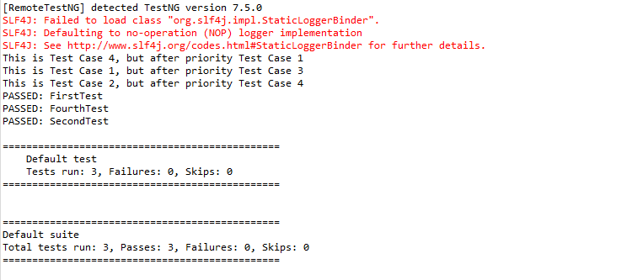

Slide 30
@Ignore Annotation
There is another way of skipping the tests by using the @Ignore annotation.
TestNG lets you ignore all the @Test methods :
In a class (or)
In a particular package (or)
In a package and all of its child packages

Slide 31
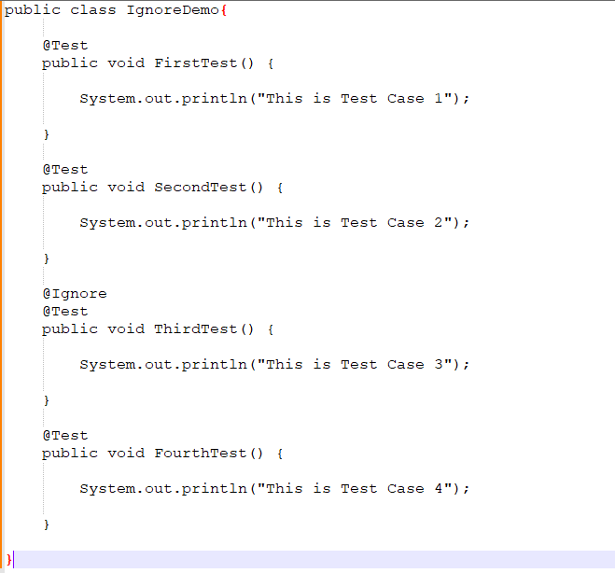
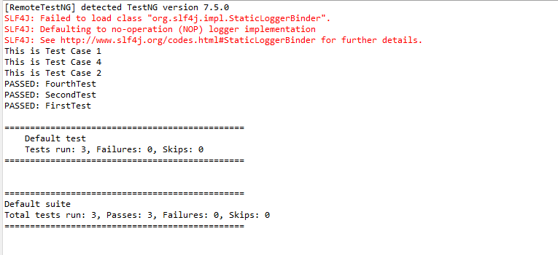

Slide 32
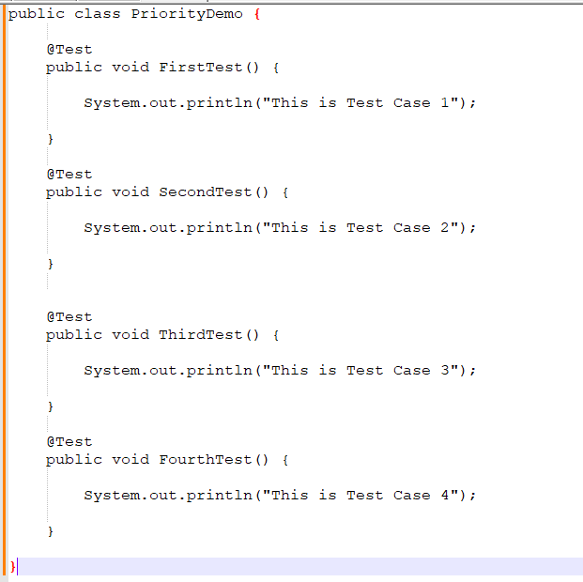
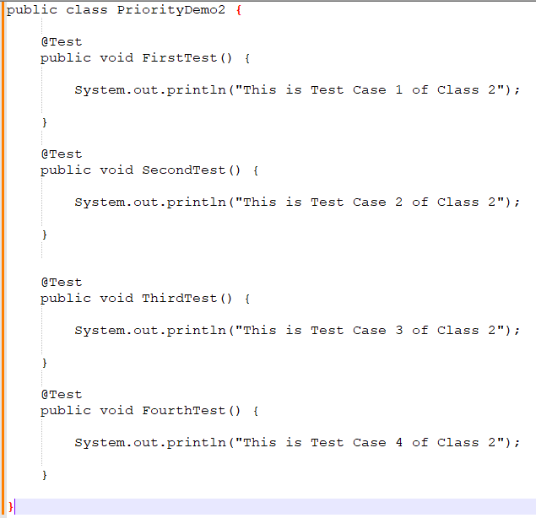
Ignore a Class
To understand this concept, we need to create 2 test classes – IgnoreDemo and IgnoreDemo2. Imagine we want to ignore all the tests in the class, so we can use @Ignore at the class level.

Slide 33
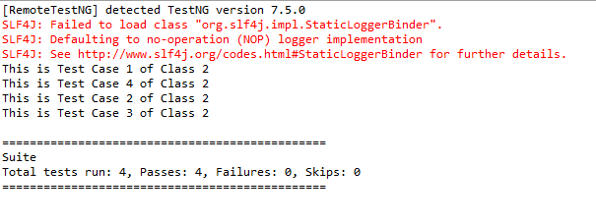
To run both the classes together, we need to create a testng.xml. The easiest way is to select both the classes and Right-Click and select TestNG -> Convert to TestNG.
Right-click on the testng.xml and select Run As -> TestNG Suite.
As we have assigned the @Ignore annotation at the class level of PriorityDemo class, it will ignore all the 4 tests present in that particular class.
The output of the above program is

Slide 34
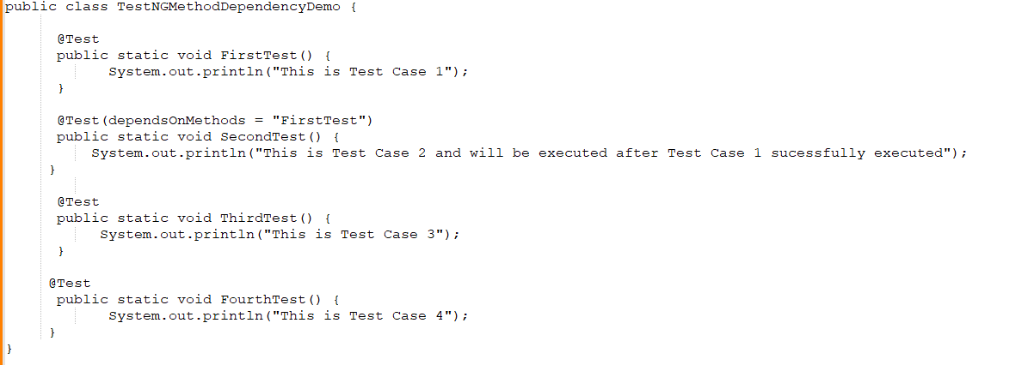
How to create dependency between Selenium Test Cases using TestNG
Imagine there is a situation that a test case can only be executed if a particular test case executes successfully. This can be achieved in TestNG by dependsOnMethod().

Slide 35
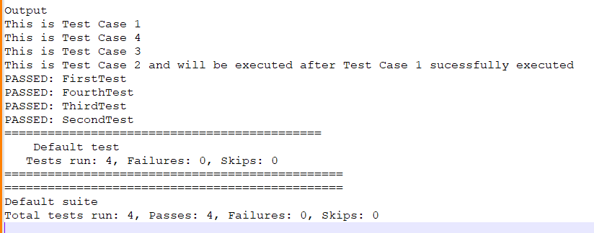
In the above scenario, Test Case 2 is dependent on Test CASE 1. If Test Case 1 fails, then Test Case 2 will skip.

Slide 36
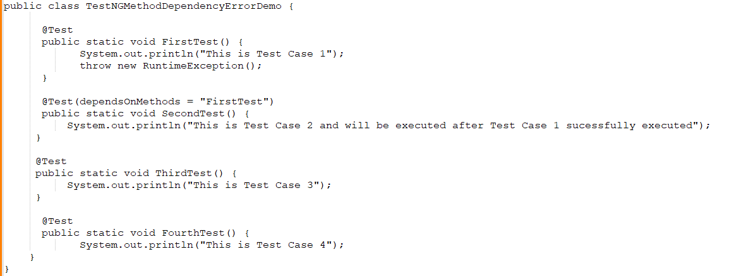
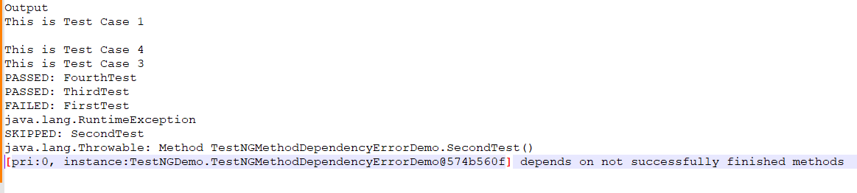

Slide 37
TestNG – How to group Tests in Selenium using TestNG
TestNg allows us to group test methods which is not present in JUnit. We can declare the methods belong to
groups as well as specify groups that contain other groups. To group test cases, we need to create testng.xml.
Multiple tags are used in a sequence to build a working testNG xml like , and
First is tag, which holds a logical name which defines full information to testNG reported to generate execution report.
2. Second is , which is a logical name which holds the information of test execution report like pass, fail, skip test cases and other information like total time for execution and group info
3. Third is , where TestNGDemo is the package used, and Test Class name is TestNGGroupDemo.
4. Fourth is , where “e2etest” is the name of the method we want to execute

Slide 38
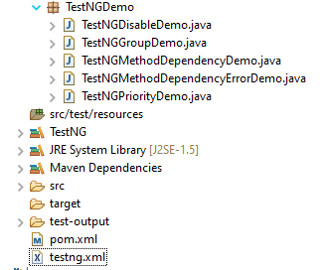

Slide 39
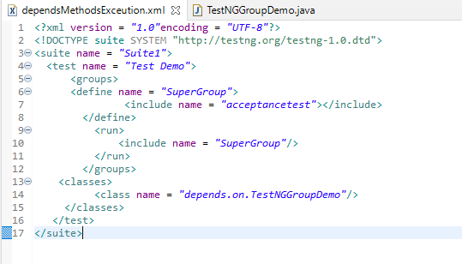
Groups of Groups
Groups can also include other groups. These groups are called “MetaGroups”. TestNG provides the flexibility of providing groups inside another group and running them according to your needs.
Let’s create a group inside a group in our XML file.
Here, I have created a created a new group with the name ‘SuperGroup‘ and included our group “acceptancetest” into it. Then we called the newly created group (SuperGroup) for execution by including it in the run tag. The output will be like this:

Slide 40
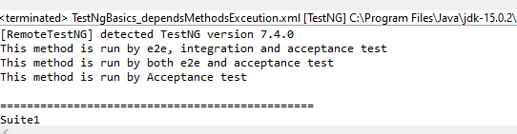
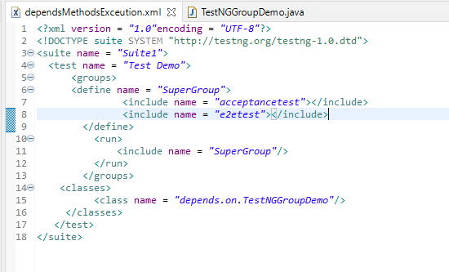
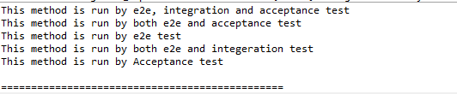
Lets, add another group “e2etest” to SuperGroup. In this case, we will see all the tests marked with “e2etest” and “acceptancetest“.

Slide 41
InvocationCount in TestNG
InnvocationCount is one of the feature available in TestNG. InvocationCount is used when we want to run the same test multiple times. If we want to run single @Test 10 times at a single thread, then invocationCount can be used. To invoke a method multiple times, below syntax is used.
@Test(invocationCount = 3)
In this example, the @Test method will execute for 3 times each on a single thread.

Slide 42
Step 1 − Create a TestNG class, TestInvocationCount.
Step 2 − Write two @Test methods in the class TestInvocationCountas shown in the programming code section below. Add invocationCount=3 to method verifyLinkedIn and 2 to validLoginTest.
Step 3 − Create the testNG.xml as given below to run the TestNG classes.
Step 4 − Now, run the testNG.xml or directly testNG class in IDE or compile and run it using command line.
Step 5 − In the output, the user can see a total of 1 thread running sequentially for all invocations of @Test.
We can add threadPoolSize to the @Test.
threadPoolSize – It defines the size of the thread pool for any method. The method will be invoked from multiple threads as specified by invocationCount.
@Test(invocationCount = 3, threadPoolSize)

Slide 44
TestNG Framework: How to run Parallel Tests in Selenium with TestNG
Parallel testing helps to reduce execution time and efforts and results in faster time to delivery. In a scenario where we have two versions of software available, and we need to check its stability and compatibility, we can run the two versions simultaneously and find issues at a much faster rate.
How to run Parallel Tests with Selenium?
TestNG provides multiple ways to execute tests in separate threads. In testng.xml, if we set ‘parallel’ attribute on the tag to ‘methods’, testNG will run all the ‘@Test’ methods in tag in a separate thread.
Let us create a class with multiple tests. In the below Example, four test cases or methods . We want to run these methods parallelly. To achieve this, we need to add the below command in testng.xml
parallel="methods"

Slide 45
The attribute thread-count allows you to specify how many threads should be allocated for this execution.
parallel = “methods” means that the methods will run parallel
The parallel attribute can be extended for multiple values, as below:
· Methods: Helps run methods in separate threads
· Tests: Help to run all methods belonging to the same tag in the same thread, means tests will run sequentially
· Classes: Helps to run all methods belonging to a class in a single thread
· Instances: Helps run all methods in the same instance in the same thread

Slide 46
Here it can be seen that 4 tests were running on thread no – 19, 20, 21 and 22. Out of all 4 tests, browser for only 1 test is closed and rest 3 browsers are left open.
First thread initialized a browser and set a value to static WebDriver reference. Second thread initialized another browser and set a new value to the same static WebDriver reference and this will impact value set by first thread as it is a static. All threads wanted to close same browser that is the reason there is one configuration method failure as one browser is closed another threads will not find sessions to close the browsers. Browser was closed already so last 3 tests did not able to close the browser.
To overcome this issue, will use ThreadLocal<WebDriver>. The complete program looks like as below:

Slide 48
Run Tests Sequentially
If you will run the Test Class – ParallelTestDemo.java as Right click and then Run As TestNG Tests, then the methods will run sequentially. Here all tests are run with Thread 1 whereas with parallel execution tests were run with different threads.
We can make parallel = none, if don’t want to run them parallel. It is shown below that all the tests are running on Thread 1 that means once a test ends then another test starts on that thread.
<suite name="TestSuite" thread-count="3" parallel="none" >

Slide 49
Cross Browser Testing using Selenium and TestNG
What is Cross Browser Testing?
Cross Browser is a technique in which a web application tests on different browsers and operating systems. Cross Browser testing, make sure that the site rendered the same in every browser.
Suppose, we have to execute 25 tests cases to test a web application on Google Chrome Browser and it takes around 4 hrs to execute these tests. However, we do not know if a user is going to access the web application on which browser. Therefore, now the same set of test cases need to executes on Firefox, Edge, Internet Explorer, Safari and Opera.
Therefore, now we need to execute 25*6=150 test cases and test execution hour changes from 4 to 24 hrs to check that the web application is working as expected. What is the best approach to handle this situation is to automate these tests and perform cross browser testing

Slide 50
Why do we need to perform cross browser testing?
Each website is built by anyone or combination of these technologies – HTML, CSS and Javascript.
Each browser uses different rendering engines to compute these technologies. Chrome uses Blink, WebKit on iOS, V8 JavaScript engine, Firefox uses Gecko, Edge uses Chromium-based with Blink and V8 engines, Safari uses Webkit rendering engine, IE uses Trident and so on.
1) Font size, image orientation and alignment mismatch in different browsers
2) Different browser is compatible with different operating systems
3) CSS,HTML validation difference can be there
Lets see an example of Cross Browser testing using Selenium and TestNG.

Slide 51
Step 1 – Add the dependencies to the POM.xml, in case of Maven project.
Step 2 – We have used Selenium WebDriver with TestNG to automate the test cases to run on 3 different browsers – Chrome, Firefox and Edge
Step 3 – The test are running on all 3 browsers in parallel as we have used parallel=“tests”
Step 4 – thread-count=”3″ means that 3 threads will start and each browser will use a thread
Step 5 – @Parameters(“browser”) – parameter will be passed from testng.xml
Let us create a helper class which contains the methods to initialize the browser and close the browser.

Slide 52
BaseClass
CrossBrowserTests

Slide 53
Xml File

Slide 54
Screenshot of Failed Test Cases in Selenium WebDriver
We are going to use TestNG to capture screenshot of failed test cases.
We will be using below mentioned features of TestNG
1) ITestResult – This Interface will provide us the result of test case execution. @AfterMethod method can declare a parameter of type ITestResult, which will reflect the result of the test method that was just run.
2) @AfterMethod – The annotated method will be run after each test method. Any @AfterMethod can declare a parameter of type java.lang.reflect.Method. This parameter will receive the test method that will be called once this after the method as run.
3) result.getName() – will return name of test case so that screenshot name will be same as test case name
4) @BeforeTest – The annotated method will be run before any test method belonging to the classes inside the tag is run.
5) @AfterTest – The annotated method will be run after all the test methods belonging to the classes inside the tag have run.
We are executing 2 test cases. One of the Test Case will pass and another will fail. This program will only capture the screenshot of failed test case, not the passed one as we have used condition

Slide 55

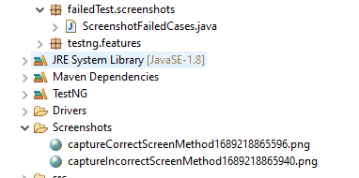
ScreenshotFailedCases
A folder with name Screenshots is created and the screenshot is placed in that folder as you can see the image below

Slide 56
TestNG Listeners in Selenium
The listener is defined as an interface that modifies the default TestNG’s behaviour. There are several interfaces that allow you to modify TestNG’s behaviour that are called “TestNG Listeners”. It allows customizing TestNG reports or logs. There are many types of TestNG listeners available. Here are a few listeners:
IAnnotationTransformer
IAnnotationTransformer2
IHookable
IInvokedMethodListener
IMethodInterceptor
IReporter
ISuiteListener
ITestListener
When you implement one of these interfaces, you can let TestNG know about it in either of the following ways:
Using in your testng.xml file.
Using the @Listeners annotation on any of your test classes.

Slide 57
ITestListener has the following methods
OnStart – Invoked before running all the test methods belonging to the classes inside the tag and calling all their Configuration methods.
onTestSuccess – onTestSuccess method is called on the success of any Test.
onTestFailure – onTestFailure method is called on the failure of any Test.
onTestSkipped – onTestSkipped method is called on skipped of any Test.
onTestFailedButWithinSuccessPercentage– method is called each time Test fails but is within success percentage. Invoked each time a method fails but has been annotated with successPercentage and this failure still keeps it within the success percentage requested.
on Finish – Invoked after all the test methods belonging to the classes inside the tag have run and all their Configuration methods have been called.
onTestStart – Invoked each time before a test will be invoked. The ITestResult is only partially filled with the references to class, method, start millis, and status

Slide 58

Step 1) Create a class “ListenerDemo” that implements ‘ITestListener’. Add methods like onTestFailure,
onTestSkipped, onTestStart, onTestSuccess to this class
Step 2) Create another class “ListenerTestCases” for the login process automation. Selenium will execute these ‘TestCases’ to login automatically.
Step 3) Next, implement this listener in our regular project class i.e. “ListenerTestCases “. There are two different ways to connect to the class and interface.

Slide 59
ListenerDemo
ListenerTestCases

Slide 60
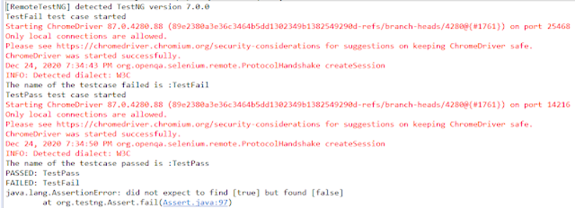
In the above test, there are 2 test cases. One Test passes and another fails. When we are executing ListenerTestCases, it will call the ListenersDemo internally.
There is another way to execute the Listener class, which is using testng.xml. There is a Listener class named “ListenerDemo” where the implementation of various methods of the listener is present. If we want to run the tests using testng.xml, then there is no need of mentioning Listeners in the ListenerTestCases class.

Slide 61
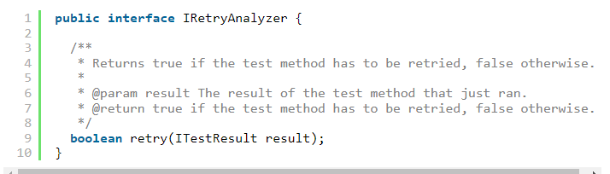
How to Retry failed tests in TestNG – IRetryAnalyzer
Imagine a scenario where we need to run a test suite consisting of 100 tests and a few tests failed as a result of a known intermittent environment issue. We know that these tests can pass if rerun a couple of times. So, in this case, the retry functionality of TestNG comes to the rescue. This is one of the best and most frequently used functionality.
In this tutorial let us study how we can implement retry on failed tests in TestNG. In order to achieve this, we have to first understand the org.testng.IRetryAnalyzer interface.
IRetryAnalyzer – It is an interface to implement to be able to have a chance to retry a failed test. The definition of this interface is

Slide 62
This method implementation returns true if you want to re-execute your failed test and false if you don’t want to re-execute your test.
When you bind a retry analyzer to a test, TestNG automatically invokes the retry analyzer to determine if TestNG can retry a test case again in an attempt to see if the test that just fails now passes. Here is how you use a retry analyzer:
Bind this implementation to the @Test annotation for e.g., @Test(retryAnalyzer = Retry.class)
Build an implementation of the interface org.testng.IRetryAnalyzer
1. Add IRetryAnalyzer to the @Test Annotation
First of all, you need to create a class that implements the IRetryAnalyzer

Slide 63

Using retryAnalyzer attribute in the @Test annotation
The next step is to associate your test cases with IRetryAnalyzer. In order to do this, you need to use the method below.
IRetryAnalyzer

Slide 64
In this example, test – verifyLoginPage() will be retried a maximum of 3 times, if the test fails. To run the tests, Right-click on the class and select Run As ->TestNG Suite.
RetryFailedTests

Slide 65
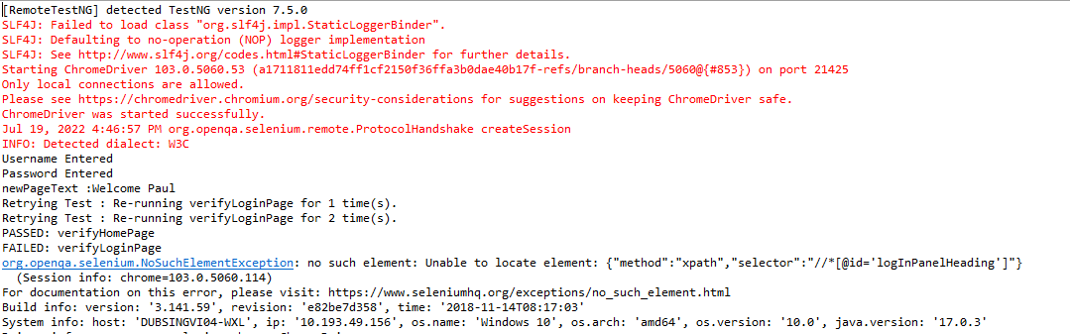
2. Implement Interface ITestAnnotationTransformer to retry failed tests
In this case, you would need to implement ITestAnnotationTransformer interface.

Slide 66
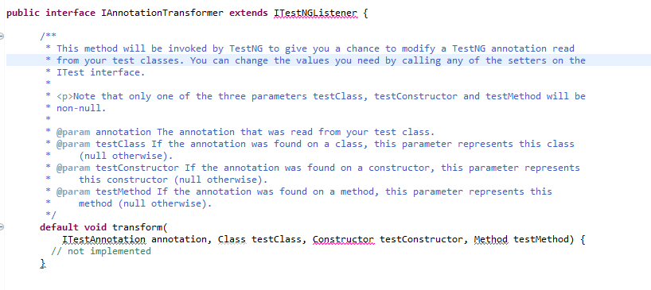
The transform method is called for every test during the test run. We can use this listener for our retry analyzer as shown below:

Slide 67
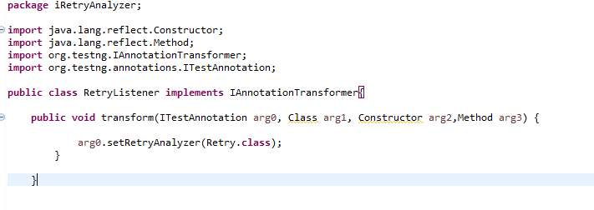
Now let us create a class that contains all the tests.

Slide 69
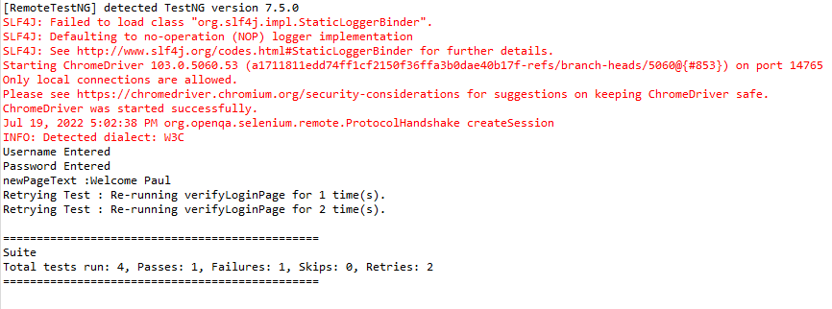

Slide 70
DataProviders in TestNG
What is DataProvider in TestNG?
The DataProvider in TestNG is another way to pass the parameters in the test function, the other one being TestNG parameters. Using DataProvider in TestNG, we can easily inject multiple values into the same test case. It comes inbuilt in TestNG and is popularly used in data-driven frameworks.
Syntax of DataProvider
@DataProvider (name = "name_of_dataprovider")
public Object[][] dpMethod() {
return new Object [][] { values}
}

Slide 71
A Data Provider is a method on the class that returns an array of array of objects. This method is annotated with @DataProvider
A @Test method specifies its Data Provider with the dataProvider attribute. This name must correspond to a method on the same class annotated with @DataProvider(name=”…”) with a matching name.
TestNG dataprovider returns a 2d list of objects..An array of objects (Object[][])
where the first dimension’s size is the number of times the test method will be invoked
and the second dimension size contains an array of objects that must be compatible
with the parameter types of the test method.
DataProviders are not declared on top of the functions like TestNG parameters but have a method of their own, which in regular speaking terms called a dataprovider method. For example, dpMethod here.
The dataprovider name calls the dataprovider method, and if there is no name specified by the tester, then the dataprovider method is the default name used in the receiving @Test case.
Data providers can run in parallel with the attribute parallel.

Slide 72
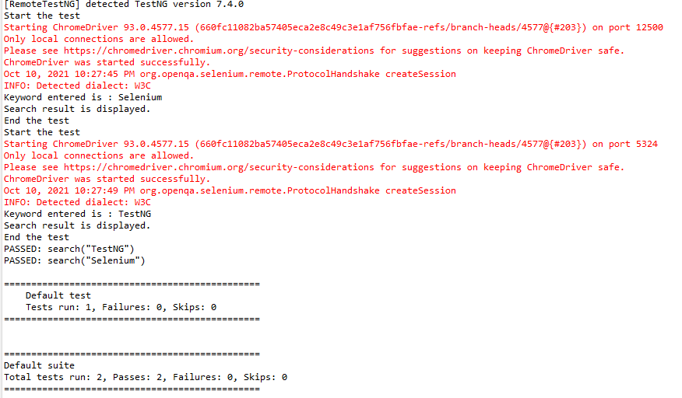

Slide 73
Inheriting DataProvider in TestNG
It is messy to have supporting methods like DataProvider and test code in one class. It is always preferred to declare the test case in one class and define TestNG parameters like DataProviders in another class. By default, the data provider will be looked for in the current test class or one of its base classes. If you want to put your data provider in a different class, it needs to be a static method or a class with a non-arg constructor, and you specify the class where it can be found in the dataProviderClass attribute.
Let us create separate classes for the DataProvider method and the test method, as shown below:

Slide 75
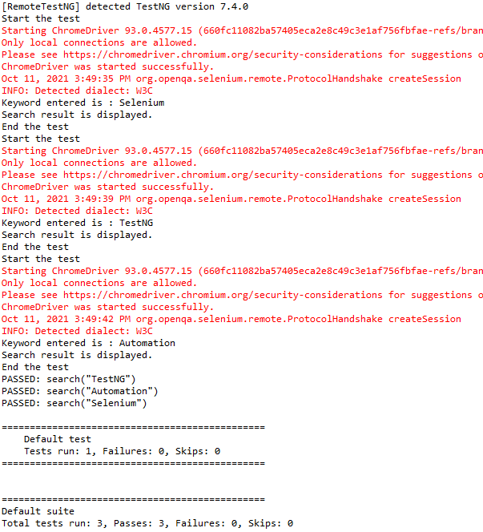
As you can see, to handle the inheritance, all we did was add an attribute to the test method

Slide 76
Passing Multiple Parameter Values in TestNG DataProviders
Passing multiple values is pretty similar to passing numerous parameters. The only difference is that we will pass various values to a single parameter so that a string of input(s) is sent in one go.
Let us quickly understand this concept with the help of the code as shown below.

Slide 78
DataProvider in TestNG using Excel
I have created an Excel – SearchInBing.xlsx and placed it on the New Folder of Disk E
Next, we will create a DataProvider method that will use another method to read the Excel file & create a 2D object from the row & column values of the Excel and return the same value, so that our test script can use it. The code for it would look like the below:

Slide 79
Now, create a class that contains the test code. By default, the data provider will be looked for in the current test class or one of its base classes. If you want to put your data provider in a different class, it needs to be a static method or a class with a no-arg constructor, and you specify the class where it can be found in the data provider class attribute.
ExcelDataProvider

Slide 80
DataProviderWithExcelDemo

Slide 81
Parallel testing of DataProviders in TestNG
TestNG is a way to pass the parameters in the test functions. Using DataProvider in TestNG, we can easily inject multiple values into the same test case. It comes inbuilt into TestNG and is popularly used in data-driven frameworks.
It is an option for the parallel execution of tests in TestNG.
It is advisable to create 2 classes – one class contains the Test cases and another class defines TestNG parameters – DataProviders.

Slide 82
An extra parameter “parallel” is required to initiate parallel execution in TestNG using the data provider.
A new ThreadLocal is instantiated for each test class, since it’s in the BeforeClass annotation.
private static final ThreadLocal<WebDriver> WEB_DRIVER_THREAD_LOCAL = new ThreadLocal<WebDriver>();
DataProviderDemo

